Slide 1
Chapter 2 The Physical Layer

Slide 2
Highlights
Some concepts
The Theoretical Basis for Data Communication
Transmission medium
Wireless Transmission
Digital modulation and multiplexing
Message switch

Slide 3
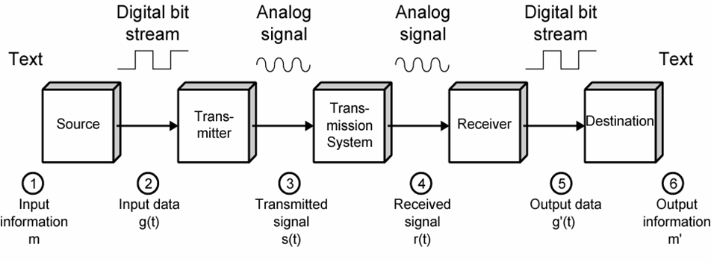
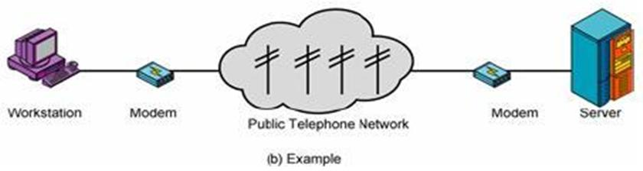
Simplified Data Communications Model

Slide 4
Fundamental Concepts (1)
信道(Channel)：传送信息的媒体
数据率(Bit Rate)：数据传输速率 (bps)
波特(Baud)：码元传输速率
1 Baud = (log₂V) bps，其中V是信号的电平级数
传播速度(Propagation Speed)：通信线路上，信号单位时间内传送的距离（米/秒）
带宽(Bandwidth)：信号占用的频率范围 (Hz)
信道容量(Channel Capacity)：信道的最大数据率
吞吐量(Throughput)：网络容量的度量，表示单位时间内网络可以传送的数据位数（bps）
误码率BER(Bit Error Rate)：信道传输可靠性指标
P= 传送错的位数 / 传送总位数

Slide 5
Fundamental Concepts (2)
时延(Delay)：从向网络中发送数据块的第一比特开始，到最后一位数据被接收所经历的时间
时延的组成：传播时延、发送时延、处理时延、排队时延
传播时延：信号通过传输介质的时间。
发送时延：设备发送一个数据块所需要的时间（数据块长度/信道带宽)
处理时延：交换机/路由器检查数据、选路的时间
排队时延：在交换机/路由器中排队等待的时间

Slide 6
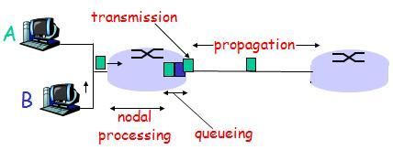
Sources of Delay (1)
2. Queueing dealy:
time waiting at output link for transmission
depends on congestion level of router
1. Nodal processing delay
check bit errors
determine output link

Slide 7
Sources of Delay (2)
3. Transmission delay:
R=link bandwidth (bps)
L=packet length (bits)
time to send bits into link = L/R
4. Propagation delay:
d = length of physical link
s = propagation speed in medium
propagation delay = d/s

Slide 8
Simplex, Half-duplex, Full-duplex
Simplex
Transmission occurs in only one direction
eg. FM Radio broadcasting
Half-duplex
Transmission can be made in both direction, but at one time only one direction is available
eg. talkie and walkie （对讲机）
Full-duplex
Transmission can be made in both directions simultaneously
eg. Phone conversation
Notes:
传输模式

Slide 9
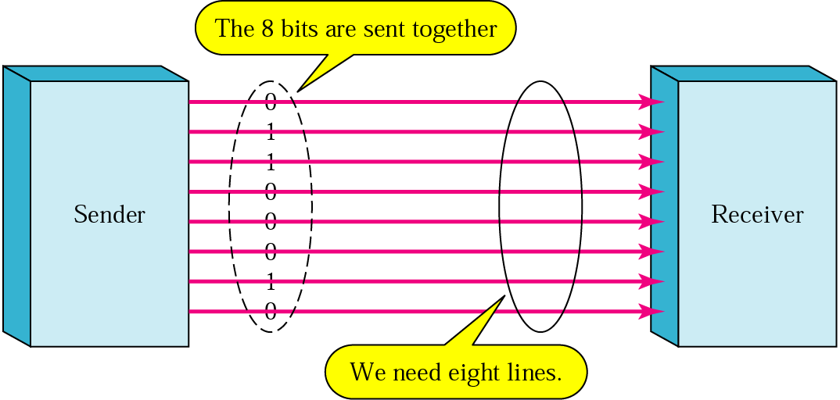
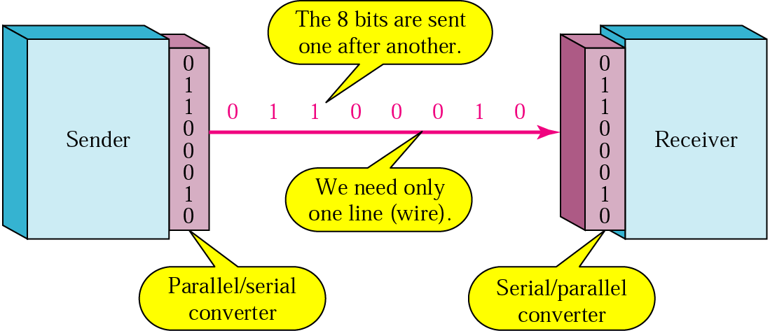
Parallel transmission vs. Serial transmission

Slide 10
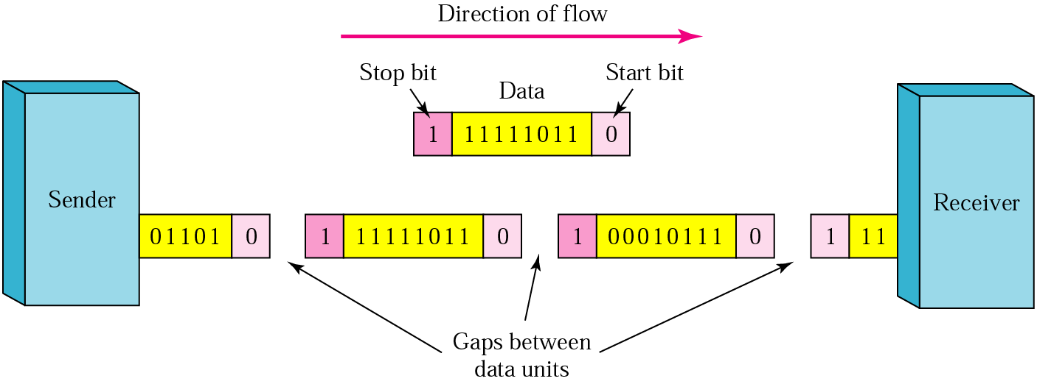
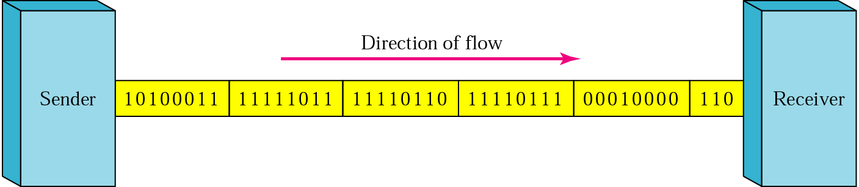
Asynchronous Transmission vs. Synchronous Transmission
Notes:
异步传输：
独立时钟，无须同步
以字符为单位进行传输
发送两个字符之间的间隔是任意的
接收方依靠字符中的起始位来同步
同步传输：以时钟来对传输进行同步
以数据块（帧或分组）为单位传输

Slide 11
同步串行传输和异步串行传输
同步串行传输
以时钟信号线对传输的数据线上的信号进行比特同步
以数据块（帧或分组）为单位传输
异步串行传输
独立时钟，无须同步
以字符为单位进行传输
发送两个字符之间的间隔是任意的
接收方依靠字符中的起始位和停止位来同步

Slide 12
2.1 The Theoretical Basis for Data Communication

Slide 13
The Theoretical Basis for Data Communication
Fourier Analysis
Bandwidth-Limited Signals
Maximum Data Rate of a Channel

Slide 14
Fourier Analysis

Slide 15
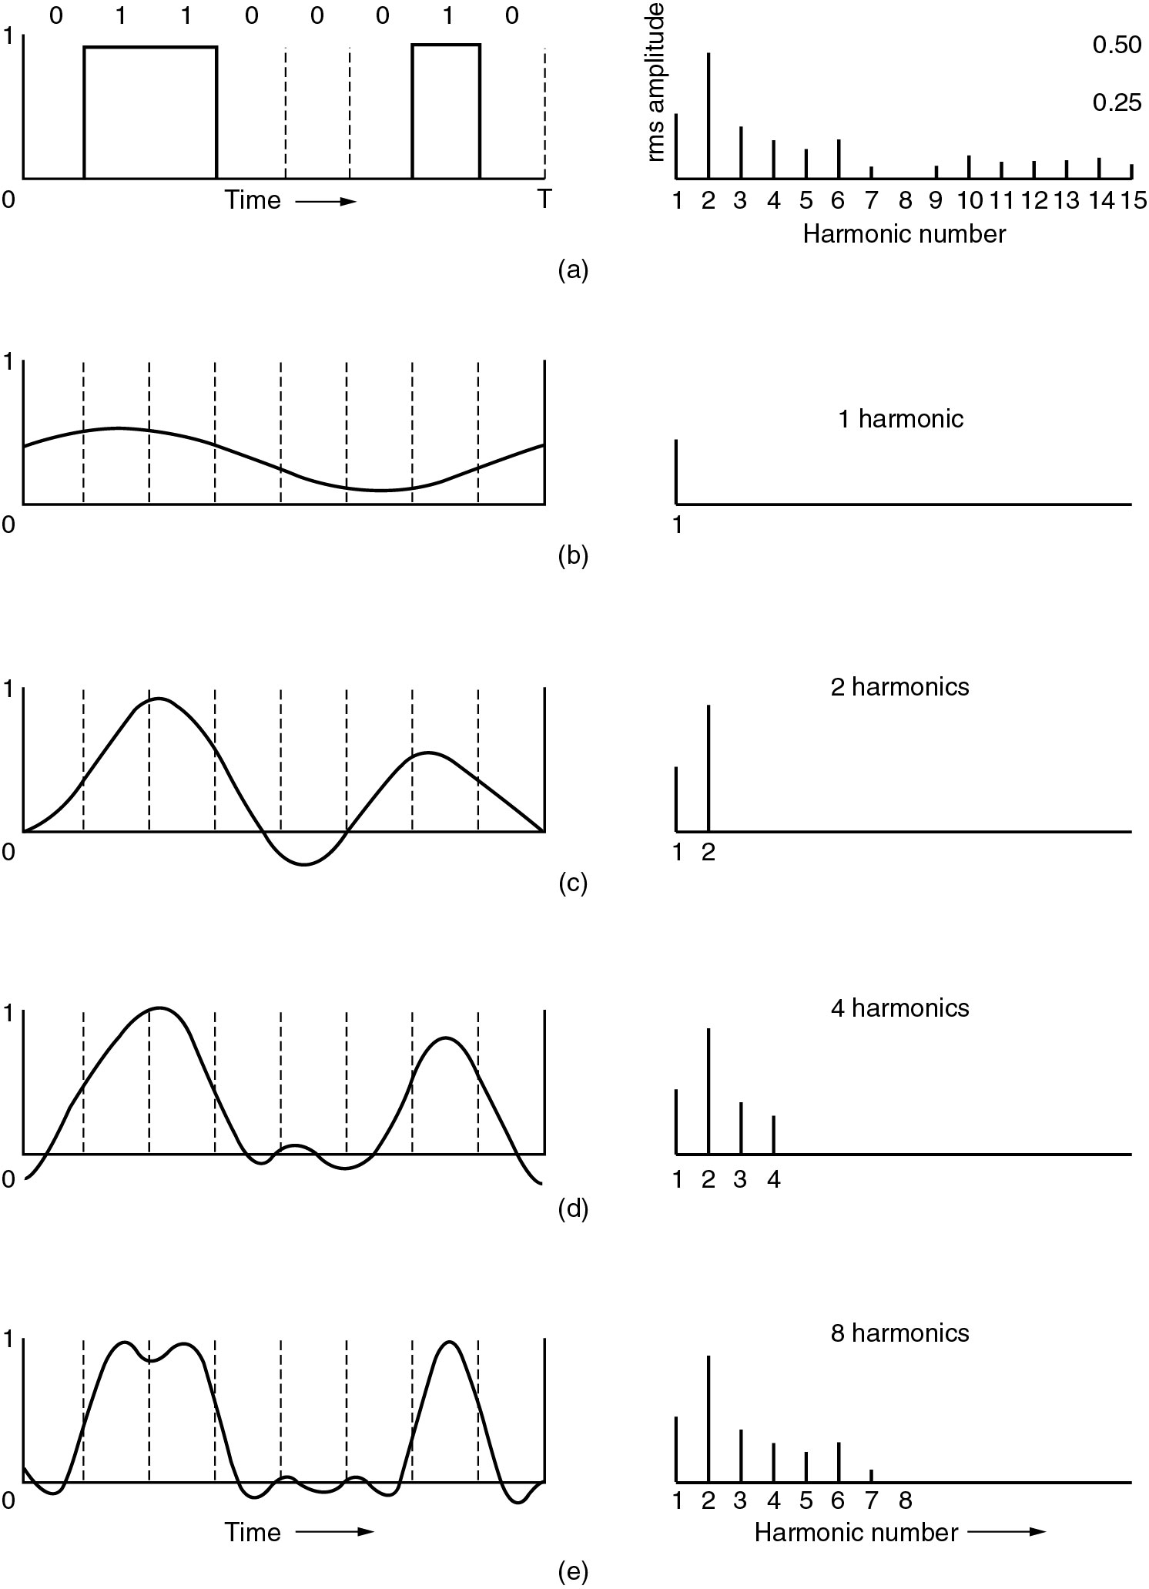
Bandwidth-Limited Signals
(a) A binary signal (‘b’) and its root-mean-square Fourier amplitudes.
(b) – (e) Successive approximations to the original signal.

Slide 16

Bandwidth-Limited Signals (2)
The range of frequencies transmitted without being strongly attenuated is called the bandwidth.
For example, a telephone wire may have a bandwidth of 1 MHz for short distances

Slide 17
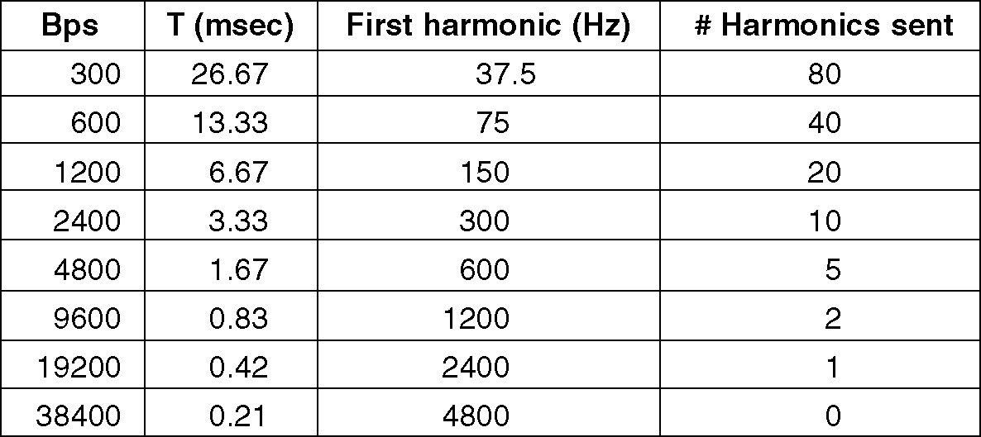
Bandwidth-Limited Signals (3)
T=8/b, first harmonic f=b/8
voice-grade line:
Max harmonics=3000/f=24000/b
When data rates ≥38.4 kbps, there is no hope at all for binary signals, even if the transmission facility is completely noiseless.
Notes:
T=1000/b*8
Hz=b/8
3000hz

Slide 18
Bandwidth
No transmission facility can transmit signal without losing some power
All transmission facilities diminish different Fourier components by different amounts
Range of frequencies transmitted without being strongly (0.5) attenuated is called bandwidth
Telephone wire’s bandwidth: 1 MHz
UTP 5: 100MHz
bandwidth is a physical property of the transmission medium, depends on
construction
thickness
length
bandwidth (Hz, bps)

Slide 19
Maximum Data Rate of a Channel
Nyquist's theorem (1924)
If a signal has been run through a low-pass filter of bandwidth H, the signal can be completely reconstructed by making 2H samples per second
C=2Hlog₂V
Shannon’s Theorem (1948)
Example: Voice phone line 300Hz-3300Hz, S/N dB=30dB

Slide 20
Maximum Data Rate of a Channel（2）
Shannon’s Theorem (1948)
Example: ADSL 1MHz, S/N dB=40dB

Slide 21
2.2 Guided Transmission Media

Slide 22
Guided Transmission Media
Magnetic Media
Twisted Pair
Coaxial Cable
Power line
Fiber Optics

Slide 23
Magnetic Media
Bandwidth (bps)
A tape can hold 800 GB,
A box can hold 1000 tapes: 800 TB,
24小时快递,
bandwidth=800T x 8bits/86400s sec=70 Gbps
Cost
tape cost $4000 per box per usage
$1000 for shipping
shipping 1 GB for under 0.5 cents

Slide 24
Twisted Pair
Category 3 UTP
Category 5 UTP
Most common transmission media, Can be used for
transmitting either analog or digital signals
Two insulated copper wires, about 1 mm thick, the
wires are twisted together in a helical form(螺旋状)
Two parallel wires constitute a fine antenna. When
the wires are twisted, the waves from 2 wires cancel
out, so the wire radiates less effectively(串扰：自身信
号对环境影响)
The bandwidth depends on the thickness of the wire and the distance traveled, several megabits/sec can be achieved for a few kilometers

Slide 25
Twisted Pair (2)
Category 3 UTP
Category 5 UTP
UTP & STP
Bandwidth
Category 3 UTP: 16MHz
Category 5 UTP: 100MHz
Category 6 UTP: 250MHz
Category 7 UTP: 600MHz

Slide 26
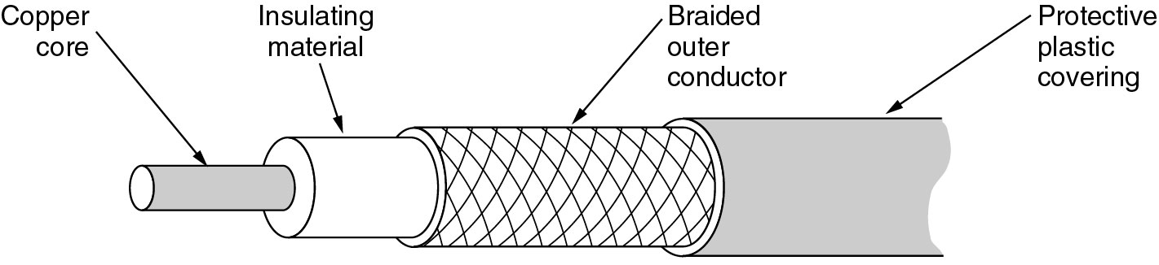
Coaxial Cable
It can span longer distances at higher speeds
Two kinds of coaxial cable are widely used
50-ohm cable, is commonly used when it is intended
for digital transmission
75-ohm cable, is commonly used for analog
transmission and cable television
High bandwidth(1GHz)
Excellent noise immunity

Slide 27
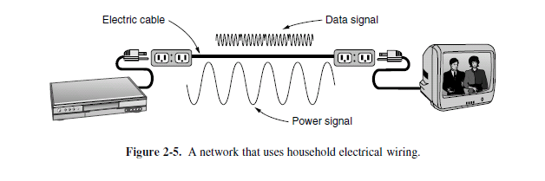
Power line
both inside the home as a LAN and outside the home for broadband Internet access
designed to distribute power signals

Slide 28
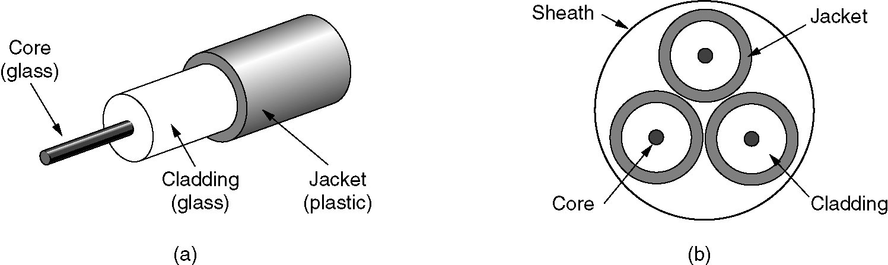
Fiber Cables
From 1981 to 2009
CPU (4.77M to 3G Hz)
A gain of a factor of 16 per decade
Physical limits: speed of light, heat dissipation
Data communication (45M to 100G bps)
A gain of a factor of 16 per decade
Error rate: 10⁻⁵ to almost 0
(a) Side view of a single fiber
(b) End view of a sheath with three fibers

Slide 29
Comparison of Fiber and Copper ware
High bandwidth
Lightweight
Security

Slide 30
2.3 Wireless Transmission

Slide 31
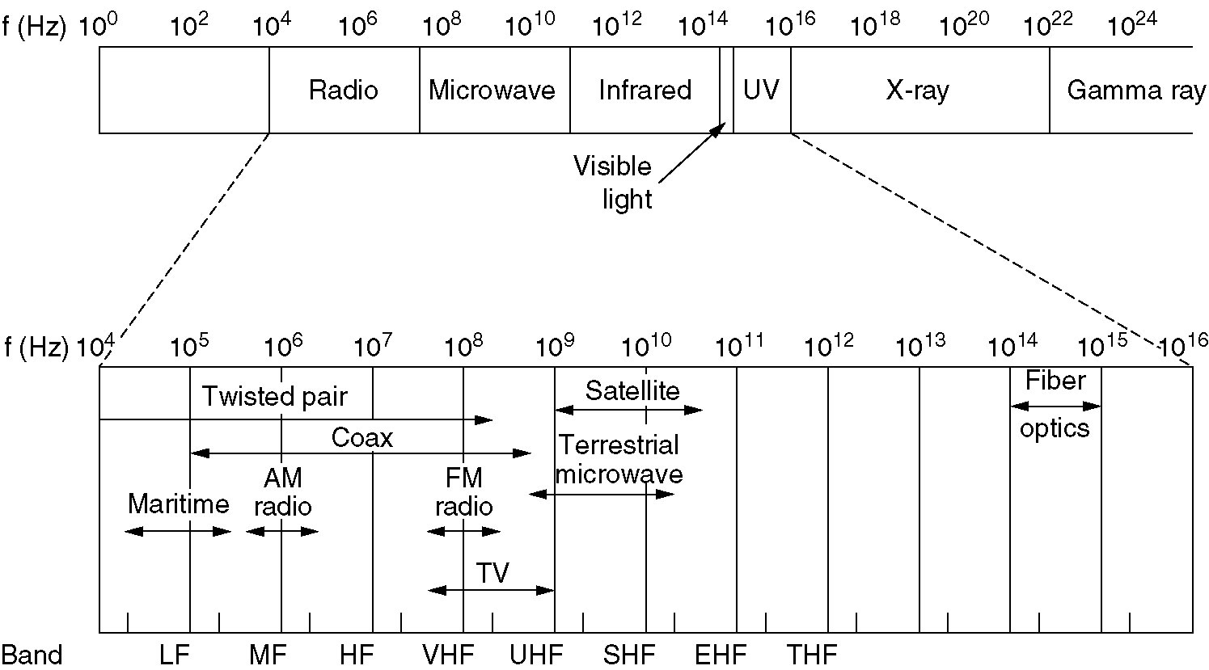
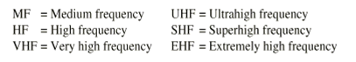
The Electromagnetic Spectrum
Electromagnetic spectrum and its uses for communication

Slide 32
Transmission Frequency Band
Using narrow frequency band
Most transmission use narrow frequency band to get the best reception
Spread Spectrum (bluetooth, wlan, cdma)
FHSS: Frequency hopping spread spectrum
Hedy Lamarr (1913-2000)
DSSS: Direct sequence spread spectrum
UWB (Ultra-WideBand) communication.
UWB sends a series of rapid pulses, varying their positions to communicate information.

Slide 33
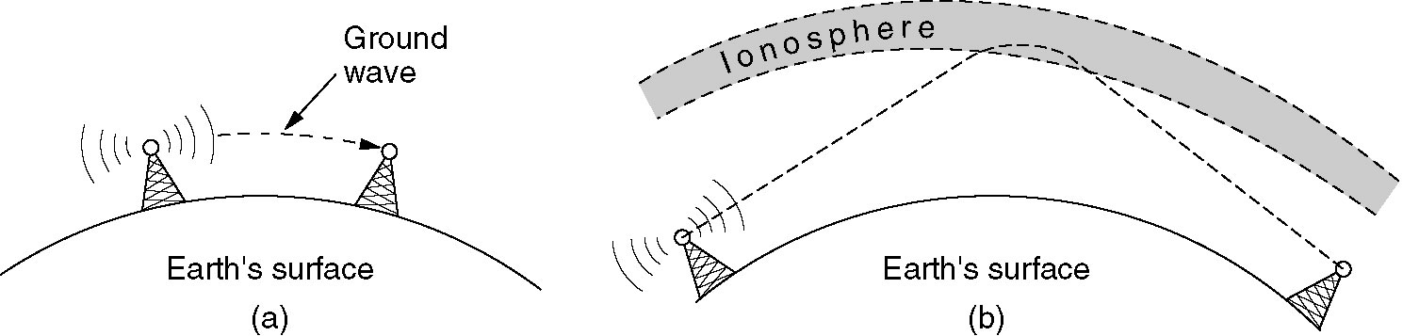
Radio Transmission (VLF,LF,MF,HF)
(a) In the VLF, LF, and MF bands, radio waves follow the curvature of the earth (1000km)
(b) In the HF band, they bounce off the ionosphere at a height of 100~500 km

Slide 34
Microwave Transmission
Microwave(100M~10GHz)
Before fiber optic, microwaves formed the heart of the long-distance telephone transmission system
waves travel in nearly straight lines, the transmitting & receiving antennas must be accurately aligned
Distance between repeaters: 80km
Multipath fading is often a serious problem (weather and frequency dependent)
(At about 4GHz, absorbed by rain)

Slide 35
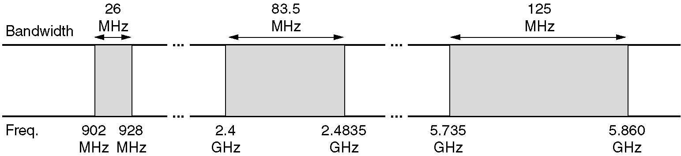
Politics of Electromagnetic Spectrum
National governments allocate spectrum
Worldwide:ITU-R; USA: FCC
ISM (Industrial, Scientific, Medical) bands
some frequency bands for unlicensed usage
FCC mandates that all devices in ISM bands use spread spectrum techniques to minimize interference between uncoordinated devices
Power is under 1 watt
（限制频率范围，调制技术，信号强度）
ISM bands in USA

Slide 36
Infrared Transmission
widely used for short-range communication
relatively directional, cheap
do not pass through solid objects
no government license is needed to operate
an infrared system

Slide 37
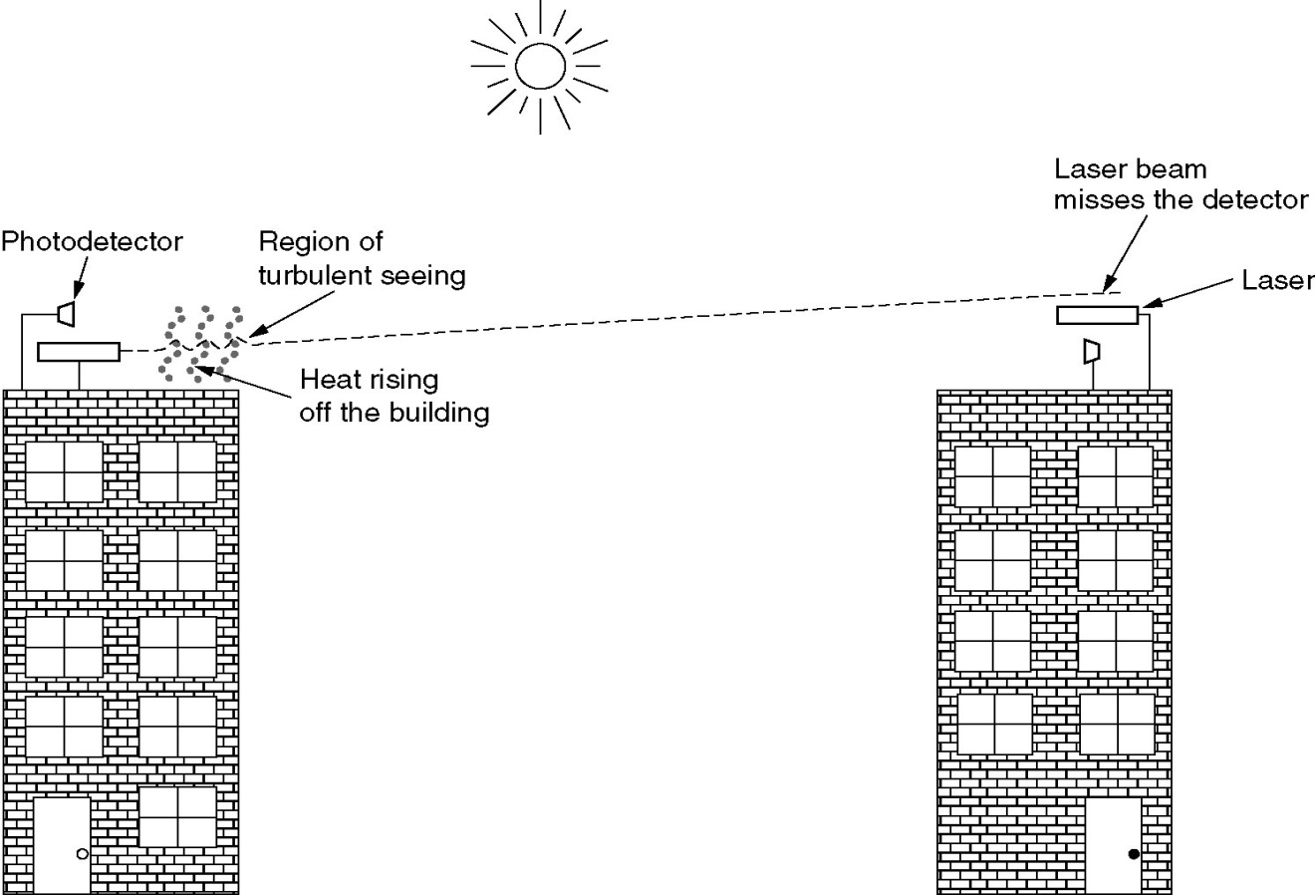
Lightwave Transmission
(Unguided optical signaling)
Aiming a 1-mm-wide laser beam at a small target 500m away, ...
Laser beams cannot penetrate rain or thick fog
Convection currents interfere with laser communication systems

Slide 38
2.4 Communication Satellites

Slide 39
Communication Satellites
Act as a big microwave repeater in the sky
Contains multiple antennas and multiple transponders
Transponder
listen to some portion of the spectrum
amplifies the incoming signals
rebroadcasts it at another frequency (downward beams)
Downward beams
Broad: a substantial fraction of the earth’s surface
Narrow: spot beams cover an area hundreds of kms in diameter (bent pipe)
Station keeping
Lifetime: about 10 years
Notes:
波束

Slide 40
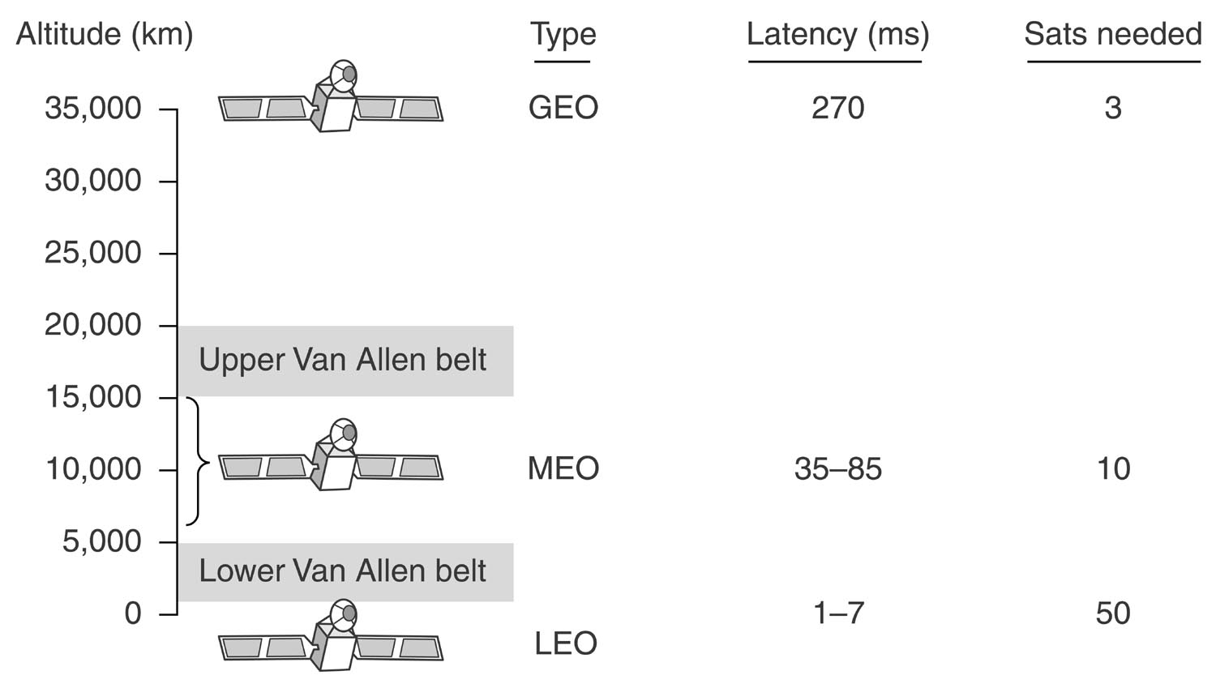
Communication Satellites and Some of Their Properties
altitude above the earth, round-trip delay time and number of satellites needed for global coverage

Slide 41
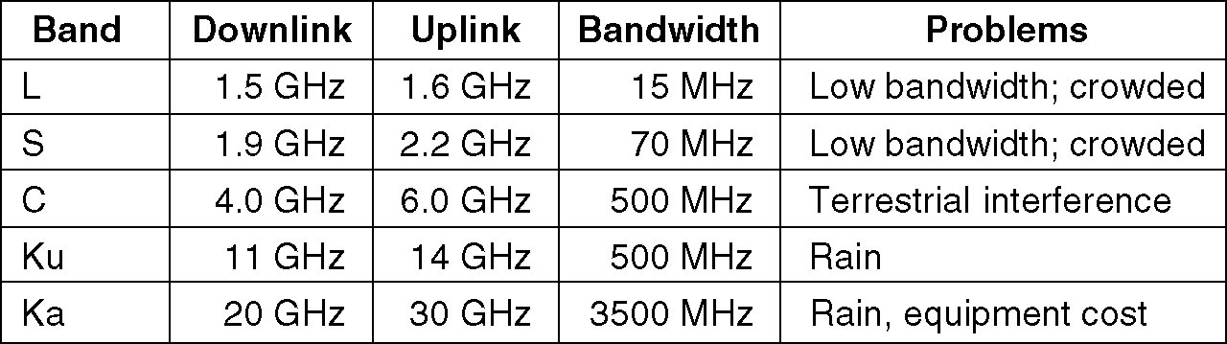
The Principal Satellite Bands
A modern satellite has around 40 transponders, each with an 80-MHz bandwidth

Slide 42
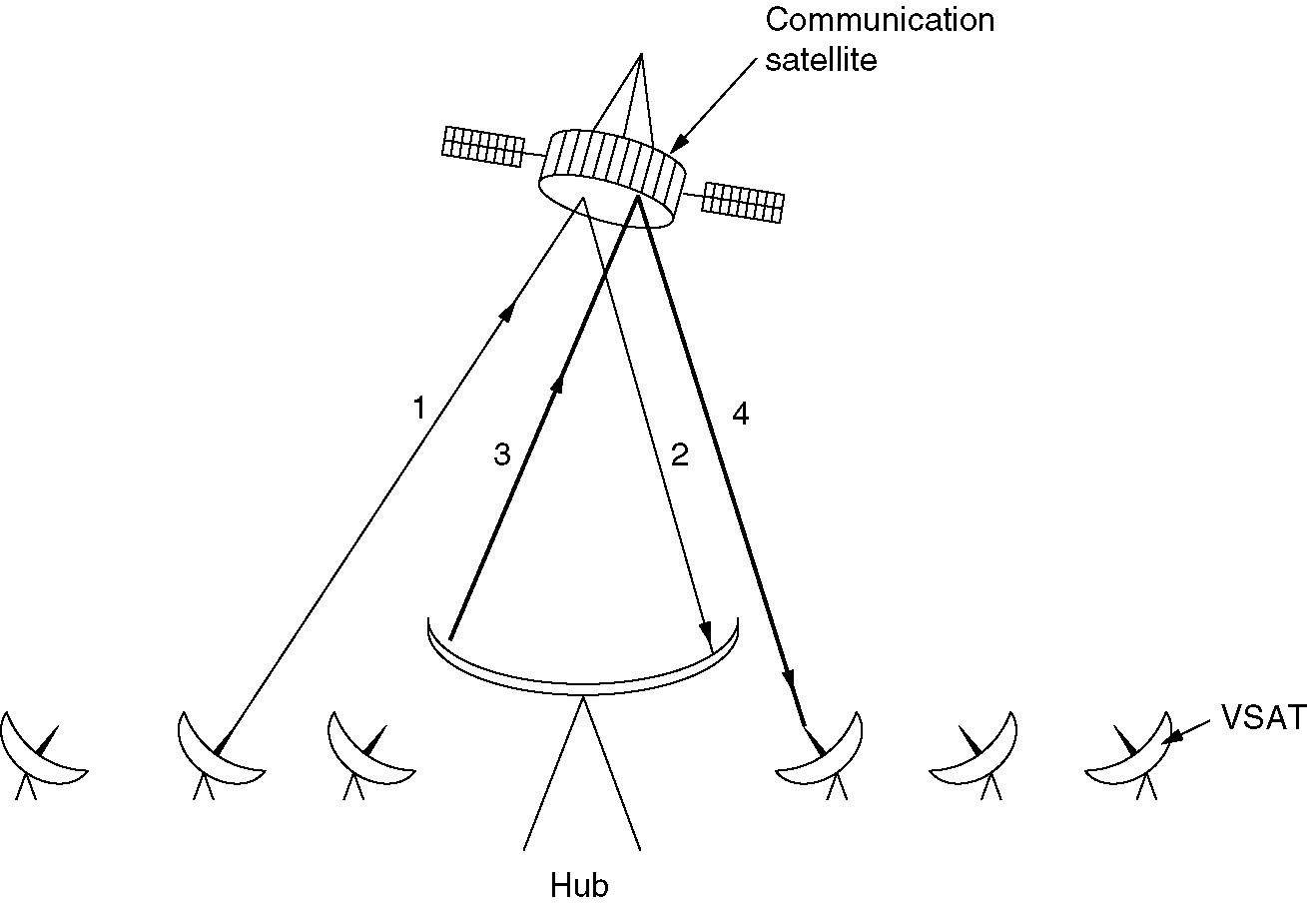
GEO: VSATs Using a Hub
Problem
Micro-station do not have enough power to communicate directly with one another via the satellite

Slide 43
LEO: Iridium
LEO
The ground stations do not need much power
Round-trip delay is only a few ms
Iridium
Altitude: 750km
6 satellite necklaces, 11x6=66 satellites
Each satellite has a max of 48 cells (spot beams)
1628 moving cells cover the earth
Communication between distant customers takes place in space
实施情况
90年策划，97年发射，98年运营，99年破产
受到移动电话网的冲击

Slide 44
Iridium Cells
(a) The Iridium satellites form six necklaces around the earth
(b) 1628 moving cells cover the earth

Slide 45
LEO: Globalstar
48 LEOs satellites
Relaying on the ground
puts much of the complexity on the ground, ease to manage
lower-powered telephones can be used (a few milliwatts)

Slide 46
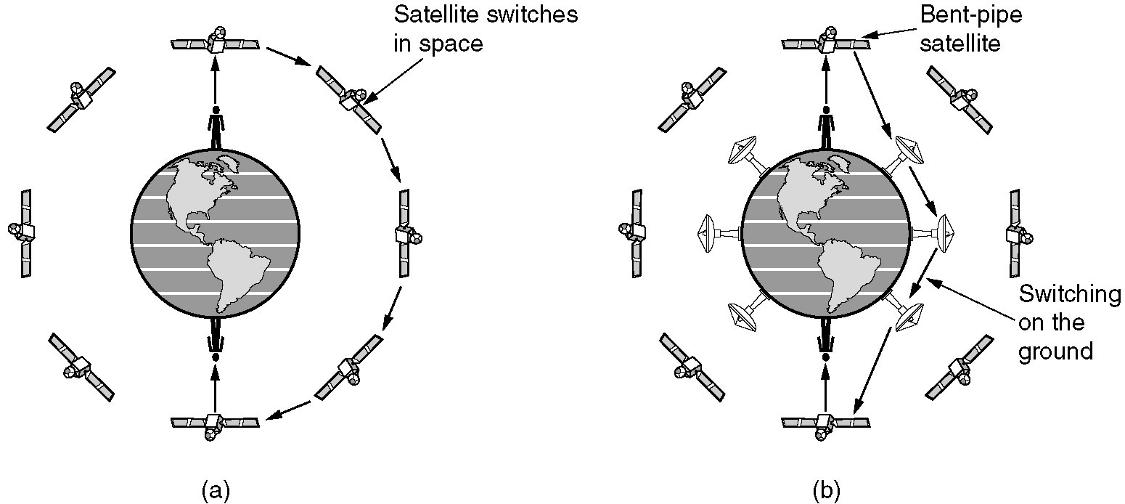
Iridium & Globalstar
(a) Relaying in space.
(b) Relaying on the ground.

Slide 47
2.5 Digital modulation and multiplexing

Slide 48
Baseband transmission
bandwidth efficiency, clock recovery, and DC balance.
NRZ
NRZI
Manchester
AMI

Slide 49
Baseband transmission

Slide 50
Baseband transmission
bandwidth efficiency
NRZ need a bandwidth of at least B/2 Hz when the bit rate is B bits/sec (C=2Hlog2V)
bit rate=baud rate * the number of bits per symbol
the number of signal levels does not need to be a power of two
clock recovery
Manchester / NRZI
4B/5B never be a run of more than three consecutive 0s
Notes:
波束

Slide 51
balanced signals
Use two voltage levels to represent a logical 1
8B/10B
The 8 bits are split into a group of 5 bits, which is mapped to 6 bits, and a group of 3 bits, which is mapped to 4 bits.

Slide 52
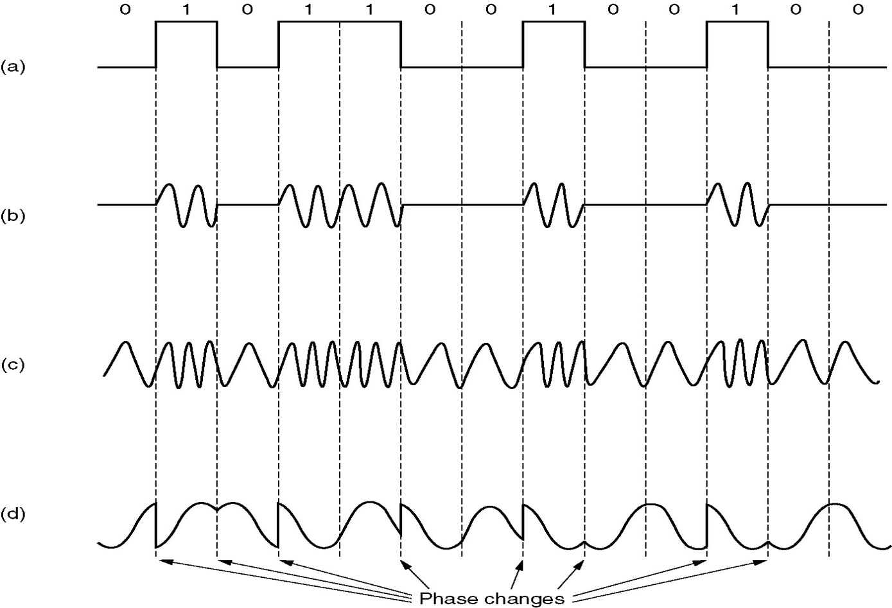
Passband Transmission
(a) A binary signal
(b) Amplitude modulation
(c) Frequency modulation
(d) Phase modulation

Slide 53
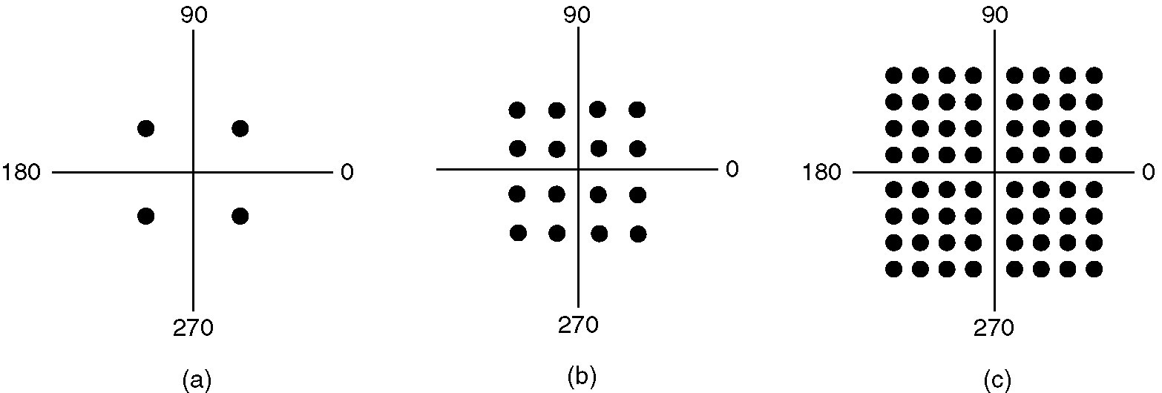
QPSK & QAM
(a) QPSK.
(b) QAM-16.
(c) QAM-64.
Notes:
QPSK 正交相移键控

Slide 54
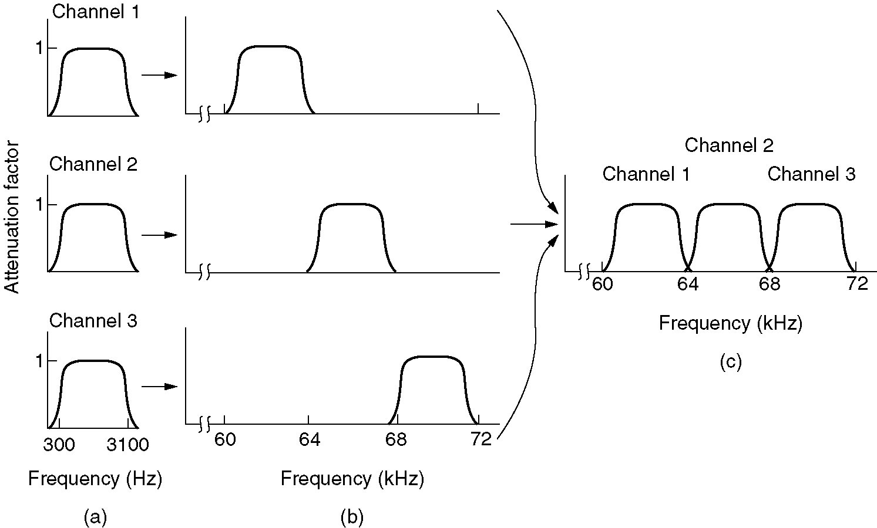
Frequency Division Multiplexing
(a) The original bandwidths.
(b) The bandwidths raised in frequency.
(b) The multiplexed channel.

Slide 55
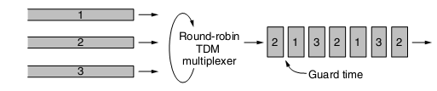
Time Division Multiplexing

Slide 56
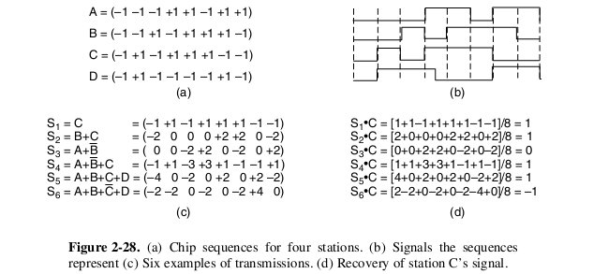
CDMA – Code Division Multiple Access

Slide 57
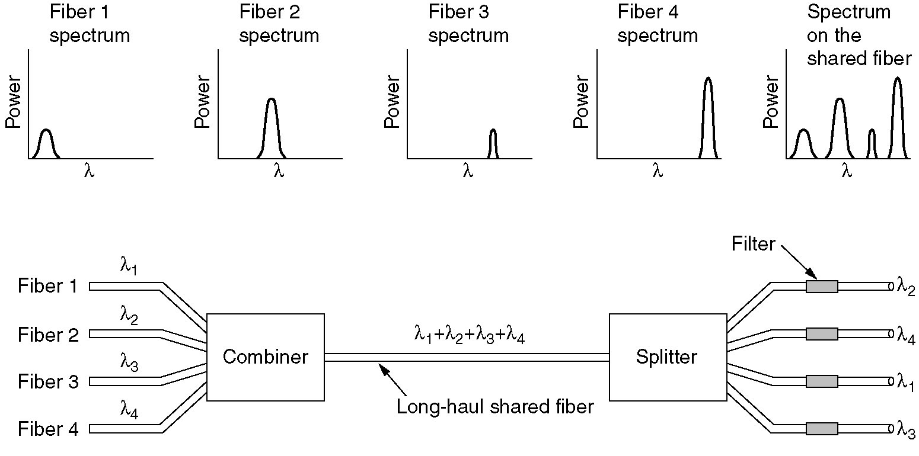
Wavelength Division Multiplexing
WDM (Wavelength Division Multiplexing).
DWDM (Dense WDM).
the bandwidth of a single fiber band is about 25,000 GHz

Slide 58
2.6 The Public Switched Telephone Network

Slide 59
Public Switched Telephone System (PSTN)
The Local Loop: Modems, ADSL and Wireless
Trunks and Multiplexing
Switching

Slide 60
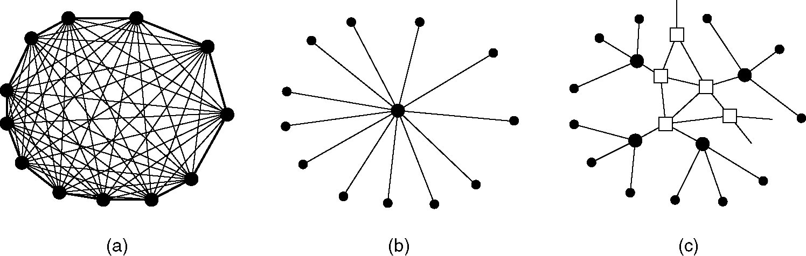
Structure of the Telephone System
(a) Fully-interconnected network.
(b) Centralized switch.
(c) Two-level hierarchy.

Slide 61
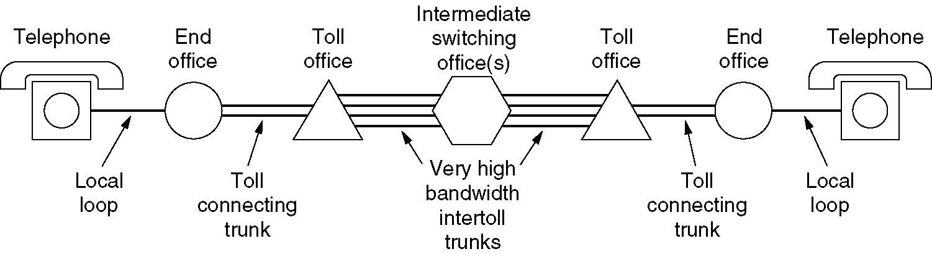
Structure of the Telephone System (2)
A typical circuit route for a medium-distance call

Slide 62
Components of Telephone System
Local loops
Analog twisted pairs going to houses and businesses
Trunks
Digital fiber optics connecting the switching offices
Switching offices
Where calls are moved from one trunk to another

Slide 63
The Local Loop Modems, ADSL, and Fiber

Slide 64
Problems
Transmission lines suffer from three major problems
Attenuation（衰减）
delay distortion（延迟畸变）
Noise
(前两项的变化程度与频率相关）
Modem & ADSL

Slide 65
Modems
The use of both analog and digital transmissions for a computer to computer call. Conversion is done by the modems and codecs.
CODEC:
8000 samples per second
1 sample = 8 bits (非线性编码)

Slide 66
Modems
Modems use a combination of modulation techniques to transmit multiple bits per baud
（multiple amplitudes and multiple phase shifts）
QPSK: Quadrature Phase Shift Keying-相移键控
QAM : Quadrature Amplitude Modulation-正交幅度调制
Modems sample 2400 times/sec and focus on getting more bits per sample
V.32: 2400 baud * (5-1) bits = 9.6Kbps
V.32bis: 2400 baud * (7-1) bits = 14.4Kbps
V.34: 2400 baud * 12 bits = 28.8Kbps
V.34bis: 2400 baud * 14 bits = 33.6Kbps
V.90(56kbps)

Slide 67
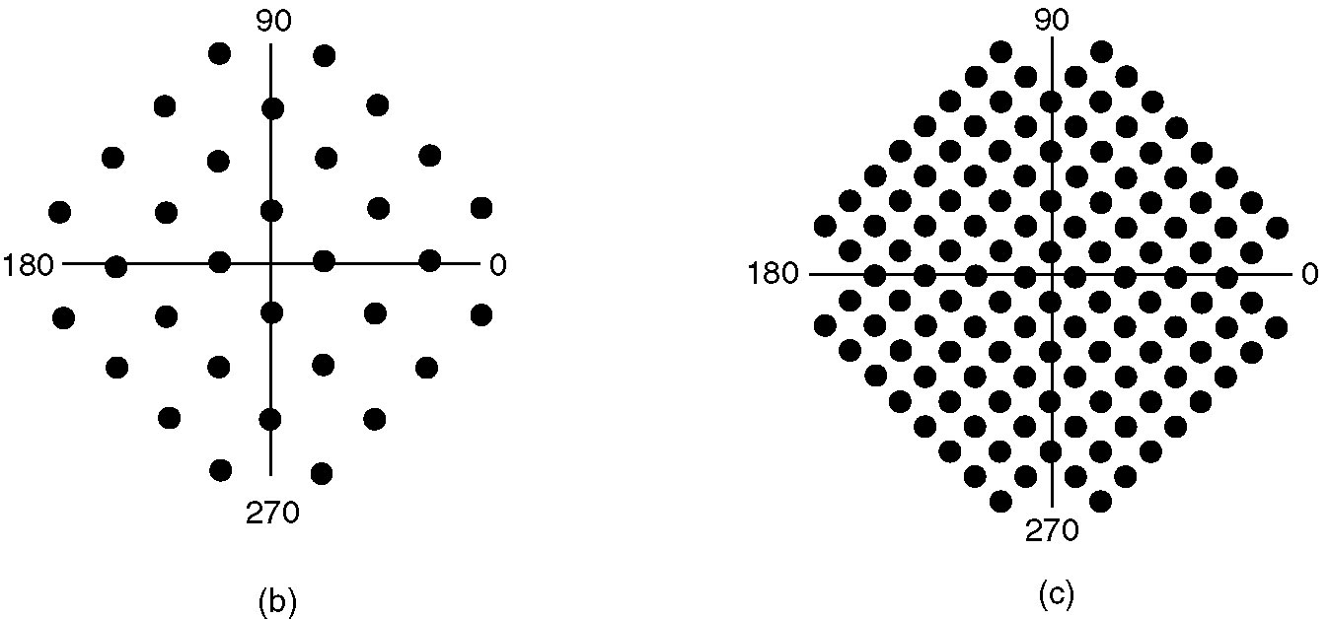
V.32 & V.32bis
(a)
(b)
(a) V.32 for 9600 bps.
(b) V32 bis for 14,400 bps.

Slide 68
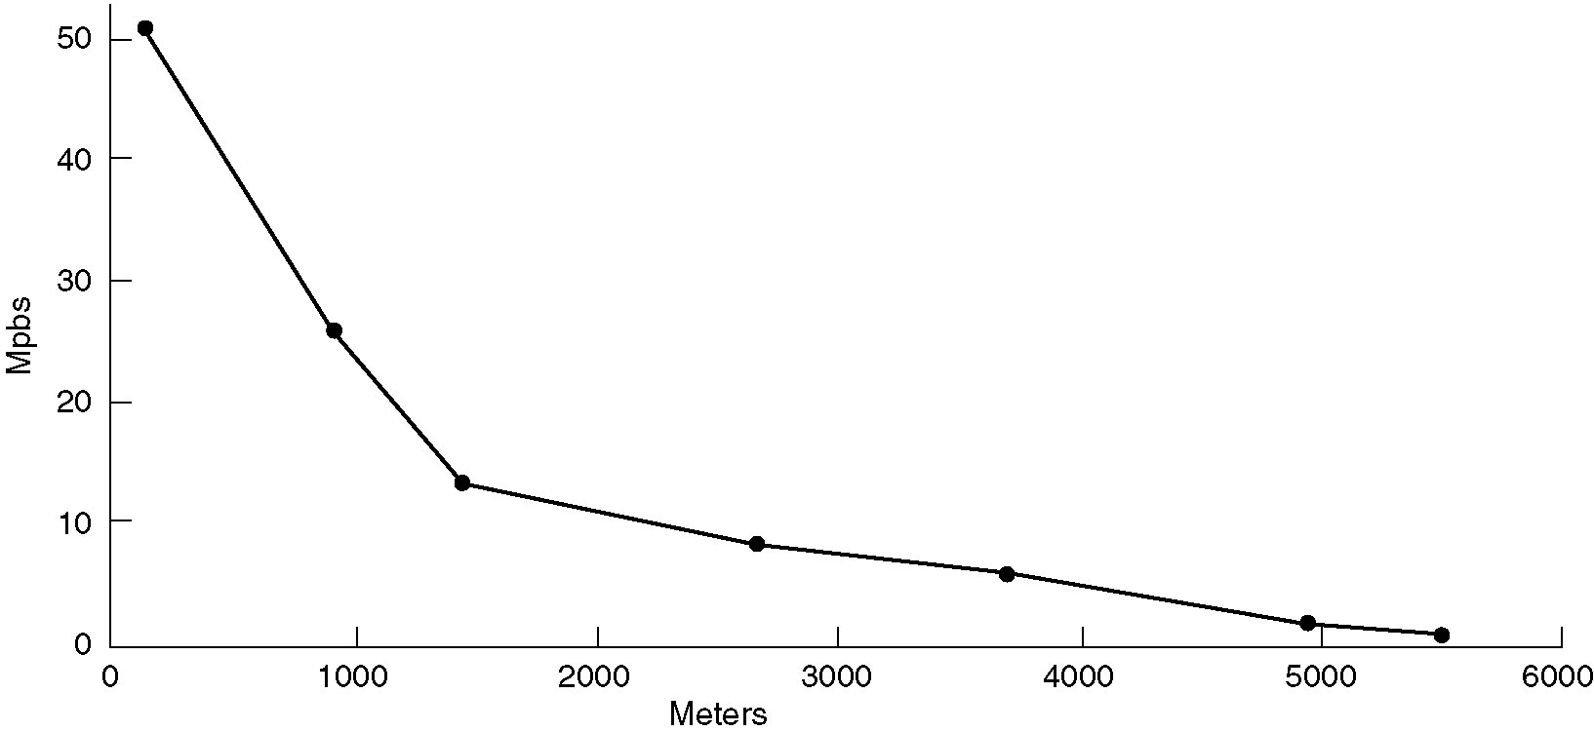
DSL: Digital Subscriber Lines
Bandwidth versus distanced over category 3 UTP for DSL.

Slide 69
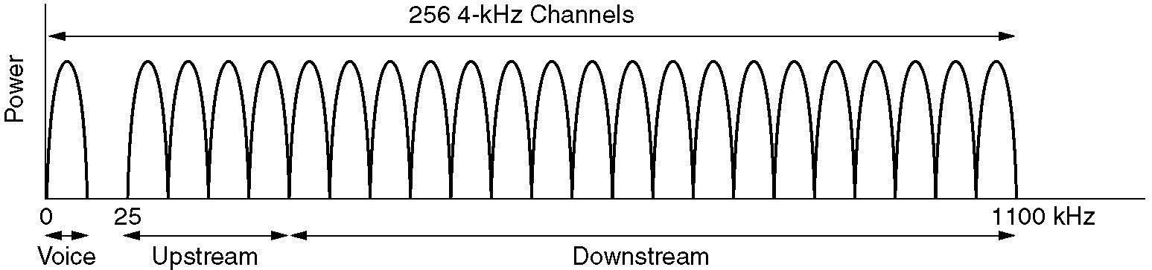
ADSL: Discrete Multitone Modulation
Divide 1.1 MHz into 256 channels of 4312.5 Hz
Channel 0 for POTS
1–5 not used, to keep voice signal and data signals from interfering with each other
250 channels
Upstream control (1)
Downstream control (1)
User data (248)

Slide 70
ADSL Modulation Scheme
Within each channel, a modulation scheme similar to V.34 is used
Sampling rate is 4000 baud
The line quality in each channel is monitored and data rate adjusted continuously
The actual data are sent with QAM modulation, with up to 15 bits/baud
G.dmt
8Mbps, 1Mbps
12Mbps, 1Mbps ADSL2；24Mbps ADSL2+
Standard service: 1 Mbps, 256 kbps
Improved service: 4 Mbps, 1 Mbps
Premium service: 8 Mbps, 2 Mbps
Notes:
标准改进和高级

Slide 71
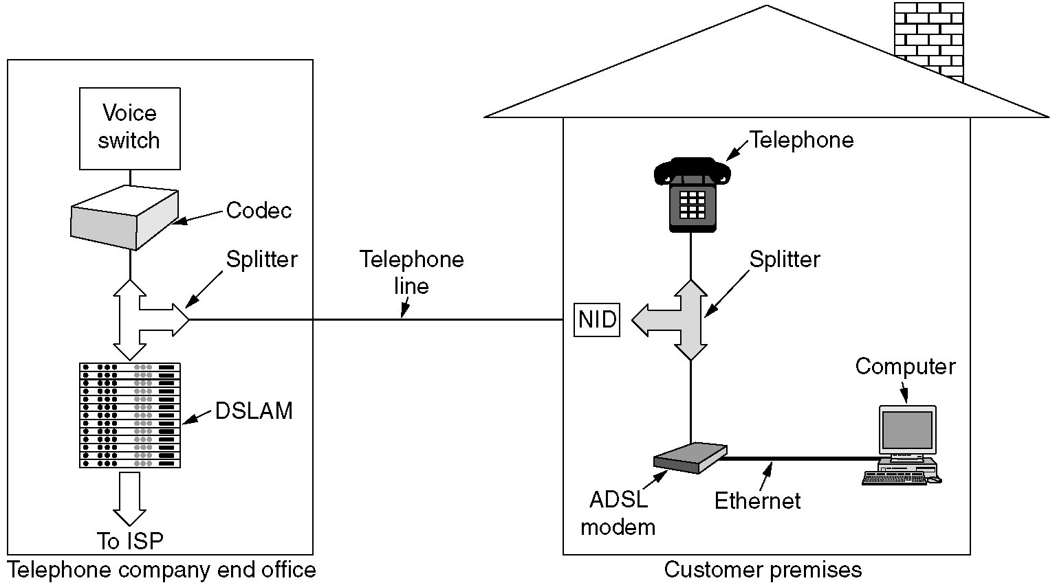
A typical ADSL equipment configuration
Notes:
Digital Subscriber Line Access Multiplexer (DSLAM)

Slide 72
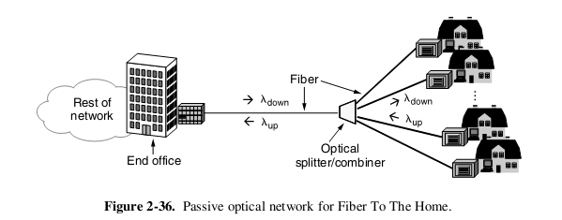
FttH

Slide 73
Trunks and Multiplexing

Slide 74
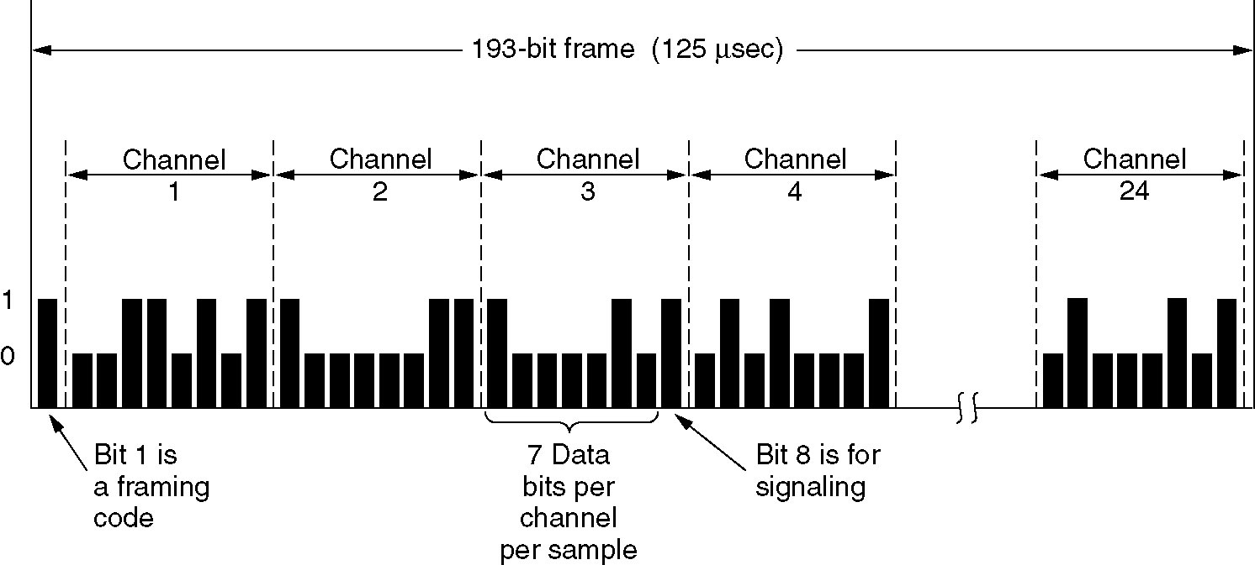
Time Division Multiplexing
The T1 carrier (1.544 Mbps).
E1 2.048Mbps

Slide 75
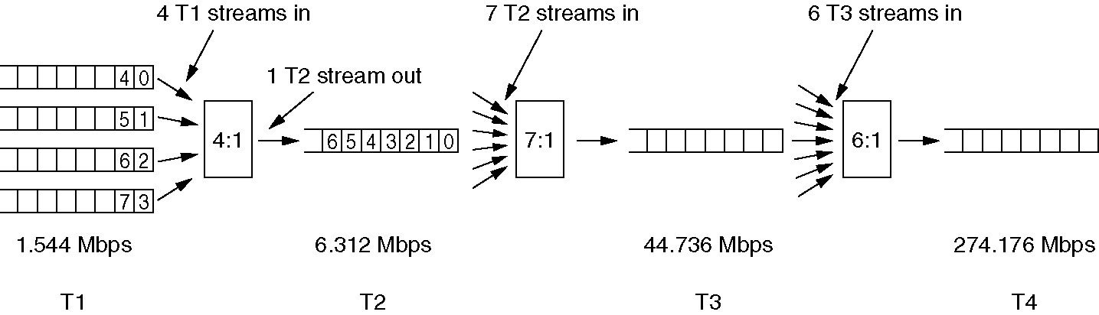
Time Division Multiplexing (2)
Multiplexing T1 streams into higher carriers.

Slide 76
Switching

Slide 77
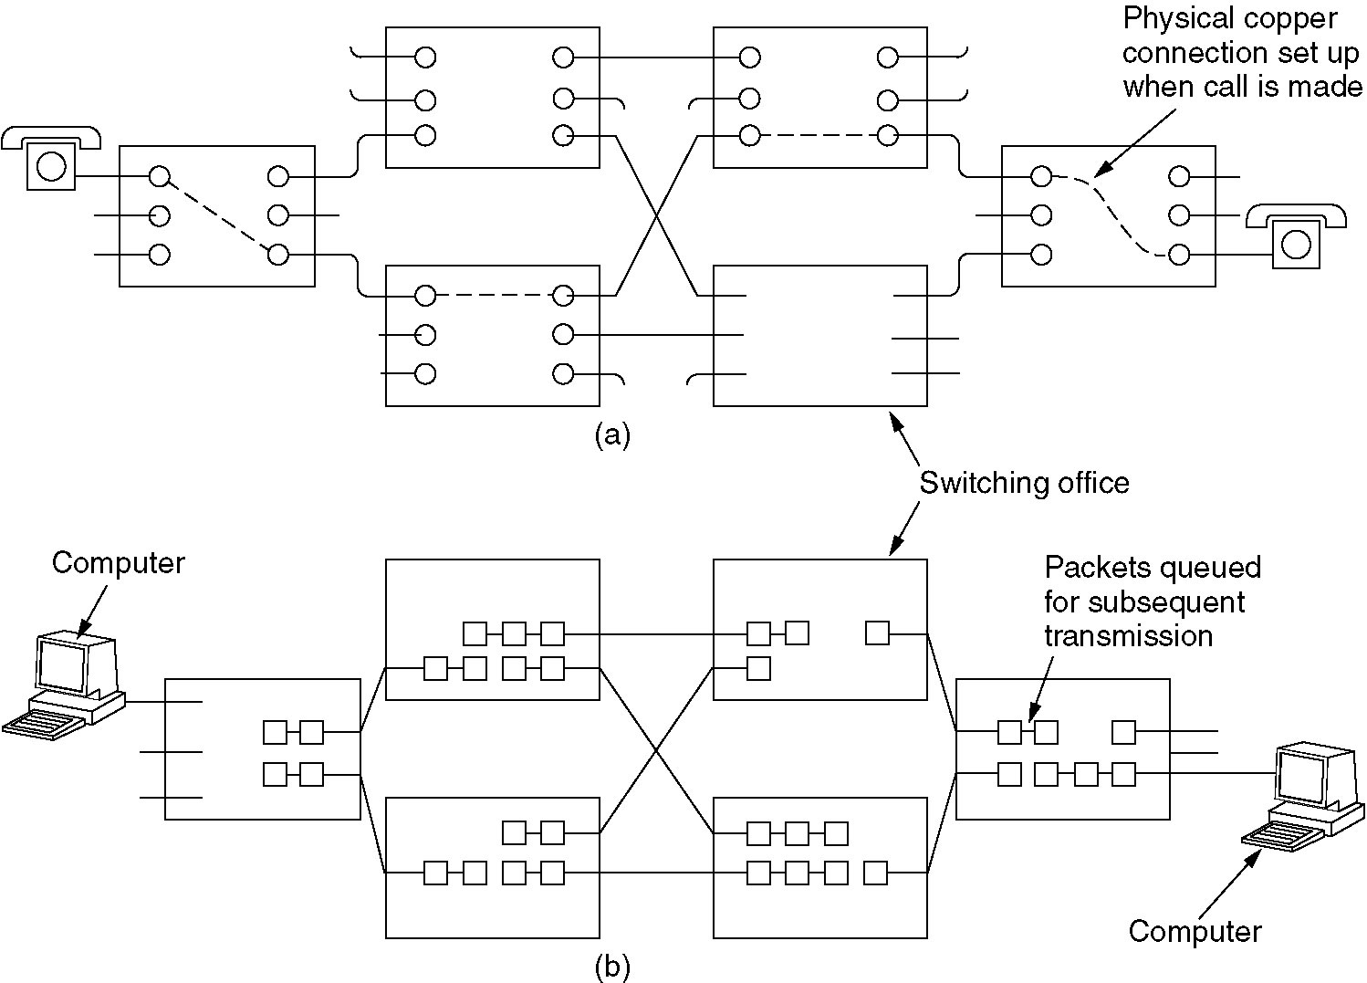
Circuit Switching
(a) Circuit switching.
(b) Packet switching.

Slide 78
Packet switching
A node in a packet switching network
incoming links
Node
outgoing links
Memory

Slide 79
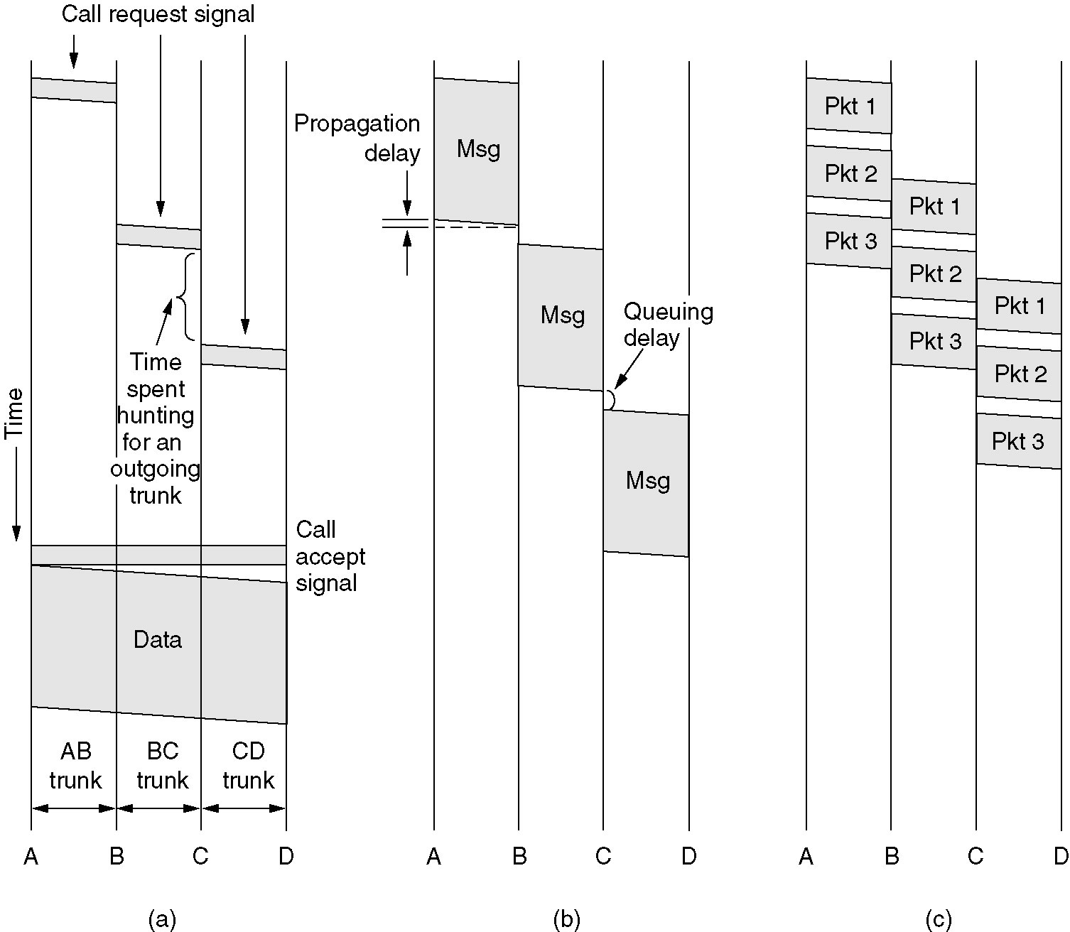
Message Switching
(a) Circuit switching (b) Message switching (c) Packet switching

Slide 80
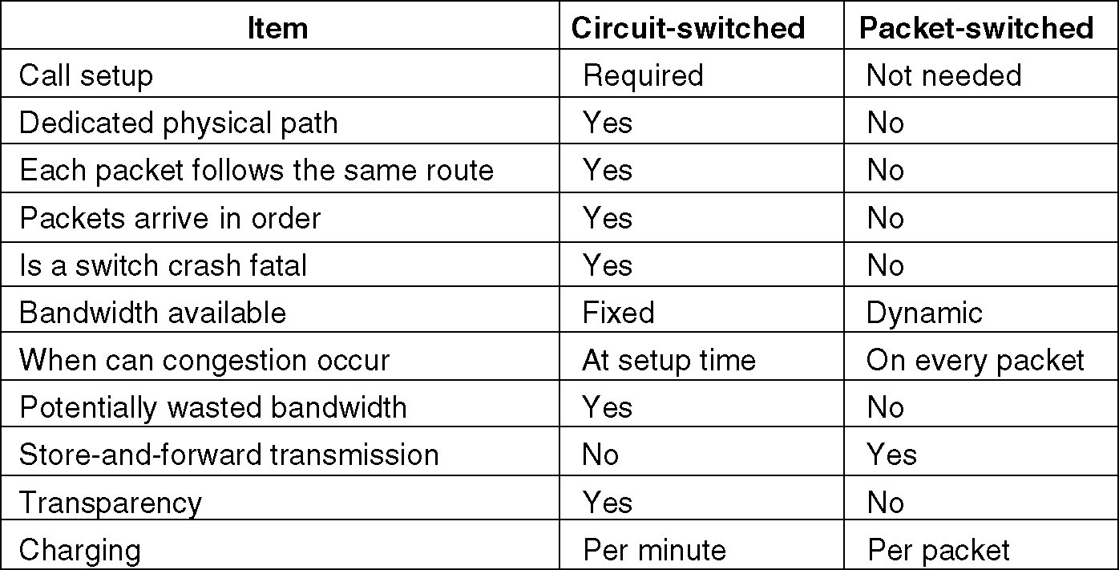
Circuit switched and packet-switched networks
.

Slide 81
2.7 Physical Interface

Slide 82
物理层接口特性
机械特性 指明接口所用接线器的形状和尺寸、引线数目和排列、固定和锁定装置等等
电气特性 指明在接口电缆的各条线上出现的电压的范围
功能特性 指明某条线上出现的某一电平的电压表示何种意义
过程特性 指明对于不同功能的各种可能事件的出现顺序

Slide 83
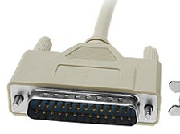
Physical Interface
EIA RS-232 （ITU-T V.24）
First issued by EIA in 1969
EIA-232-C EIA-232-D EIA-232-E
Interface standard between DTE and DCE
DTE Data Terminal Equipment
DCE Data Circuit Equipment

Slide 84
RS-232
Mechanical ：25-pin
Electrical：<-3V “1”， >3“0”
data rate 20Kbps
cable <15 m
Functional：pin definition
Procedure： protocol

Slide 85
RS-232 ：signal
DTE: data terminal equipment
DCE: data communications equipment
TD: Transmitted data
RD: Received data
RTS: Request to send
CTS: Clear to send
DSR: data set ready
CD: Data Carrier detection
DTR: Data Terminal Ready

Slide 86
Virtual MOEM

Slide 87
Virtual MOEM(2)
DTE
DTE
2
TD
2
3 RD
3
7 GND
7

